Slide 1
Picking (on) Parking Parking Choice Models in the New TRM

Slide 2
Background

Slide 3
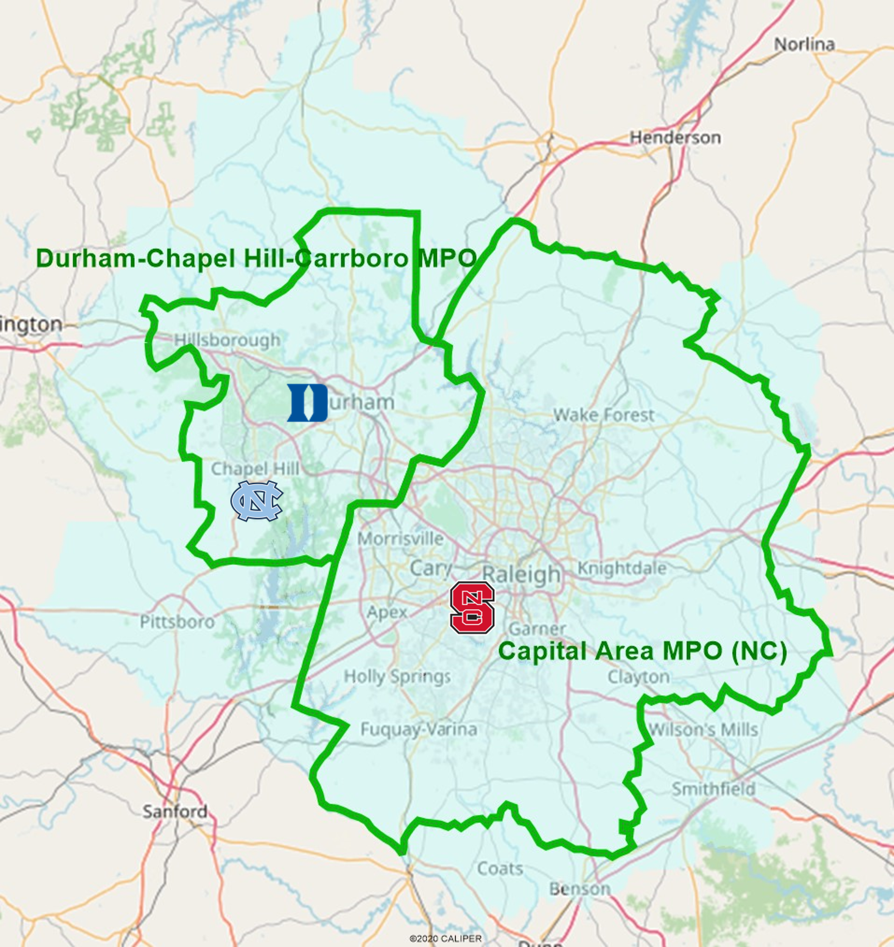
The NC Research Triangle
Raleigh-Durham Metro
  Very multi-nucleated
  Chapel Hill, Cary, Wake Forest
  Major Research Institutions
  Tech Industry
  Affluent
1.9 Million People
2 MPOs – 1 Model

Slide 4
A Hybrid Trip-based Model
Disaggregate front end, aggregate back end
Trips, but segmented by tour type
Advanced component models
  Machine Learning, Destination Choice
Linkage of Home-based & Non-home-based trips
Population Synthesis
Trip Generation
Non-Motorized Models
HB Destination Choice
Home-based Mode Choice
Non-Home-based Models
Parking Model

Slide 5
Why model Parking?
Parking is priced and limited in parts of the Triangle
Parking prices/availability impact people’s destination and mode choices
Without parking model
  not enough transit use around CBDs & campuses
  too much auto demand in core CBDs & campuses

Slide 6
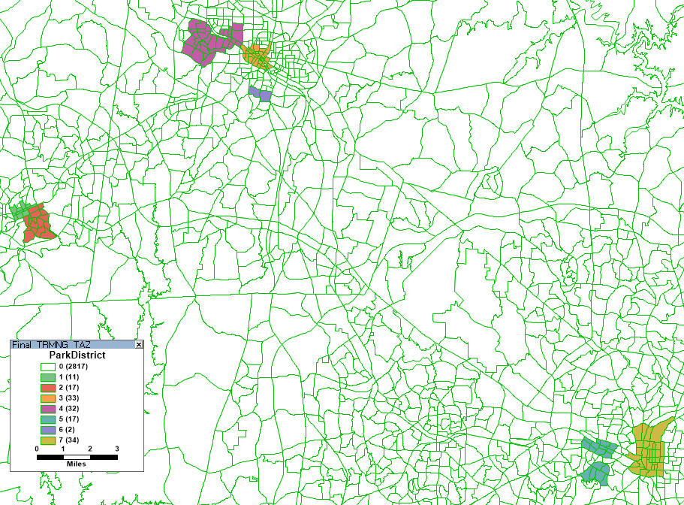
Parking districts
Parking model applied only where parking is limited and paid for
  CBD Zones (3)
  University Zones (4)
Parking choice is restricted to within district
Duke
Durham CBD
NC Central
Chapel Hill CBD
UNC Chapel Hill
Raleigh CBD
NCSU

Slide 7
Data

Slide 8
2016 Parking Survey
Survey conducted
October 2015 – March 2016
Internet survey
  Most recruitment through universities & businesses
  Some in-person intercept
  for non-workers
3,559 surveys collected
  (55% CBD / 45% University)

Slide 9
2016 Parking Survey
Combined revealed and stated preference questions
Estimated MNL models of mode choice with drive-park-walk and drive-park-shuttle alternatives in addition to bus and walk/bike

Slide 10
Adapting the Model

Slide 11
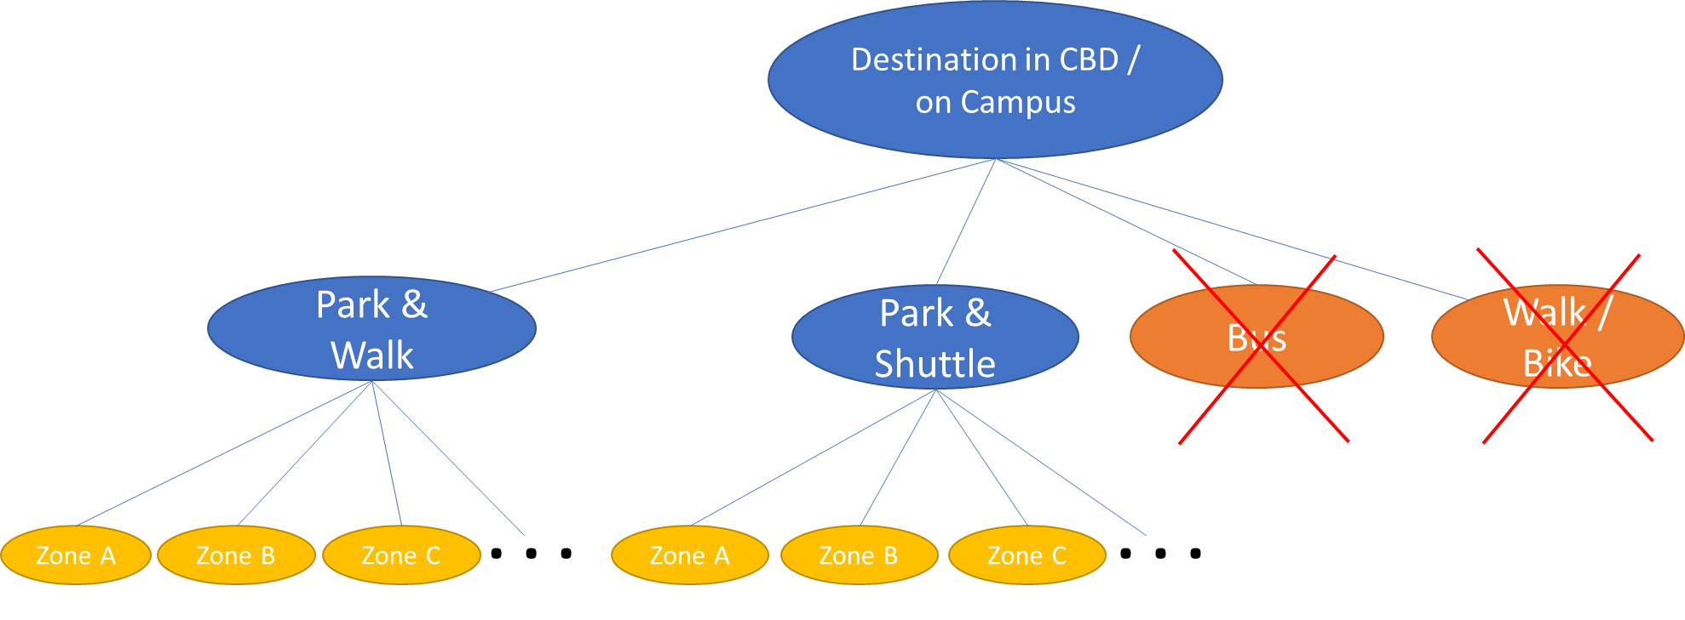
Adapting the Survey Model
Dropped non-parking modes (OK because of IIA)
Added destinations under modes using the same cost and time coefficients from mode choice for destination choice

Slide 12
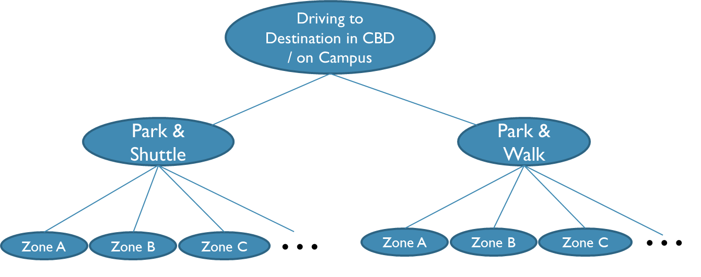
Resulting Parking MOdel
Actually, still MNL mathematically
But applied as nested logit

Slide 13
Resulting Parking MOdel
Mode utilities are just logsums of destination utilities plus ASC

Slide 14
Application

Slide 15



Getting from Here to There
Start with Origin to Destination
Need Origin to Parking & Parking to Destination

Slide 16
Application Methodology
Trip Matrix
We start with OD trip matrix
And parking probabilities,
which we transpose
 | 1 | 2 | 3
1 | 100 | 50 | 40
2 | 30 | 10 | 20
3 | 20 | 10 | 20
Parking Probabilities (T)
 | 1 | 2 | 3
1 | 0.9 | 0.1 | 0
2 | 0.1 | 0.8 | 0.1
3 | 0.2 | 0.1 | 0.7
Parking Zones
Destination Zones

Slide 17
Application Methodology
Trip Matrix
We do proper matrix multiplication to get the Origin to Parking matrix
 | 1 | 2 | 3
1 | 100 | 50 | 40
2 | 30 | 10 | 20
3 | 20 | 10 | 20
Parking Probabilities
 | 1 | 2 | 3
1 | 0.9 | 0.1 | 0
2 | 0.1 | 0.8 | 0.1
3 | 0.2 | 0.1 | 0.7
100 50 40
x0.9 x0.1 x0.2
90 + 5 + 8 = 103
Origin to Parking
 | 1 | 2 | 3
1 | 103 | 54 | 33
2 | 32 | 13 | 15
3 | 23 | 12 | 15

Slide 18
Application Methodology
Trip Matrix
We multiply the probability matrix by the column sums of the trips
 | 1 | 2 | 3
1 | 100 | 50 | 40
2 | 30 | 10 | 20
3 | 20 | 10 | 20
 | 150 | 70 | 80
Parking Probabilities
 | 1 | 2 | 3
1 | 0.9 | 0.1 | 0
2 | 0.1 | 0.8 | 0.1
3 | 0.2 | 0.1 | 0.7
 | 1 | 2 | 3
1 | 135 | 15 | 0
2 | 7 | 56 | 7
3 | 16 | 8 | 56
Parking Zones
150
70
80
Origin to Parking
Destination Zones
 | 1 | 2 | 3
1 | 103 | 54 | 33
2 | 32 | 13 | 15
3 | 23 | 12 | 15

Slide 19
Application Methodology
Trip Matrix
We multiply the probability matrix by the column sums of the trips
And transpose
 | 1 | 2 | 3
1 | 100 | 50 | 40
2 | 30 | 10 | 20
3 | 20 | 10 | 20
 | 150 | 70 | 80
Parking Probabilities
 | 1 | 2 | 3
1 | 0.9 | 0.1 | 0
2 | 0.1 | 0.8 | 0.1
3 | 0.2 | 0.1 | 0.7
 | 1 | 2 | 3
1 | 135 | 15 | 0
2 | 7 | 56 | 7
3 | 16 | 8 | 56
150
70
80
Origin to Parking
Parking to Destination
 | 1 | 2 | 3
1 | 103 | 54 | 33
2 | 32 | 13 | 15
3 | 23 | 12 | 15
 | 1 | 2 | 3
1 | 135 | 7 | 16
2 | 15 | 56 | 8
3 | 0 | 7 | 56

Slide 20
Calibration

Slide 21
Scaling & Calibration
There is generally additional error/noise in models from stated preference experiments.
Their utility parameters thus must be scaled up to match real behavior. RSG recommended scaling by a factor of 2.
However, we calibrated the scaling factor so the applied model’s average walk time from parking to the ultimate destination matched the average from the survey.
 | Survey Walk Time | Model Walk Time | Implied Scale Factor
CBD | 7.8 min | 7.6 min | 3.97
University | 11.3 min | 11.3 min | 1.86

Slide 22
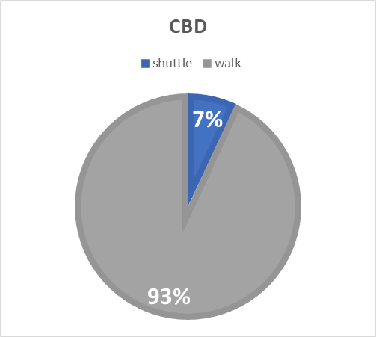
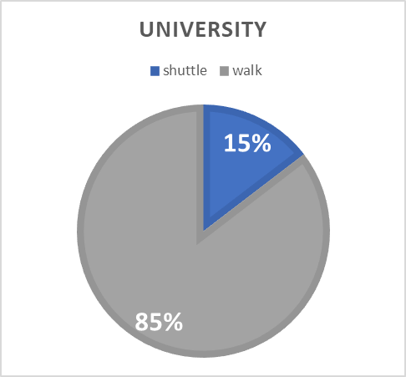
Calibration
The alternative specific constant (ASC) for the shuttle mode also had to be calibrate so the model matched the observed mode share from the survey

Slide 23
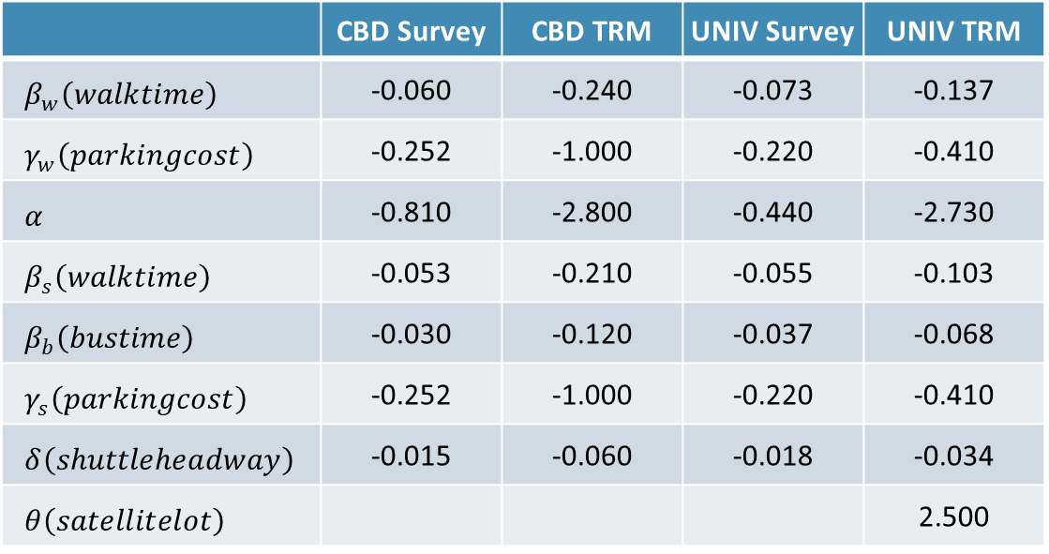
Model Coefficients
 | CBD Survey | CBD TRM | UNIV Survey | UNIV TRM
$β_{w}\left(walktime\right)$ | -0.060 | -0.240 | -0.073 | -0.137
$γ_{w}\left(parkingcost\right)$ | -0.252 | -1.000 | -0.220 | -0.410
$α$ | -0.810 | -2.800 | -0.440 | -2.730
$β_{s}\left(walktime\right)$ | -0.053 | -0.210 | -0.055 | -0.103
$β_{b}\left(bustime\right)$ | -0.030 | -0.120 | -0.037 | -0.068
$γ_{s}\left(parkingcost\right)$ | -0.252 | -1.000 | -0.220 | -0.410
$δ\left(shuttleheadway\right)$ | -0.015 | -0.060 | -0.018 | -0.034
$θ\left(satellitelot\right)$ |  |  |  | 2.500

Slide 24
Model Sensitivities
Although the coefficients are different the model sensitivities (measured as values of time) remain the same (within rounding)
 | CBD Survey | CBD Model | UNIV Survey | UNIV Model
Park & Walk Walk Time | $14.29 | $14.40 | $20.00 | $20.01
Park & Shuttle Walk Time | $12.50 | $12.60 | $15.00 | $15.00
Park & Shuttle Shuttle Time | $7.14 | $7.20 | $10.00 | $9.89
Park & Shuttle Wait Time | $7.14 | $7.20 | $10.00 | $10.00

Slide 25
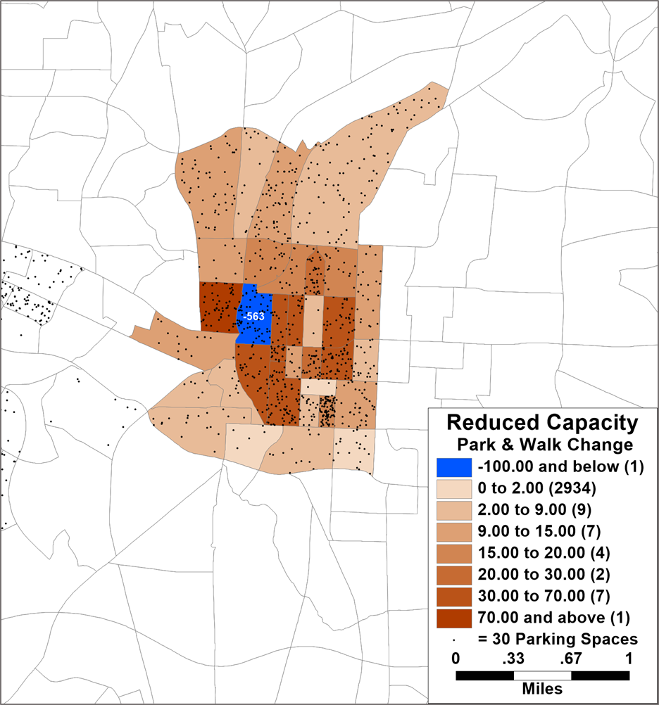
Parking sensitivity Test
Cut spaces in half
  Base: 1,789
  Test: 897
Minimal impacts on DC/MC
Large impacts on parking location
  Within that district only
  563 less trips to zone
  More to adjacent zones and zones with most parking

Slide 26
Conclusion

Slide 27
Parking in the TRM
Mode choice model from 2016 survey was adapted to model both parking mode and parking zone choice
Sensitivities were retained from the original model
Model was rescaled and calibrated to match observed shuttle share and walk distances from the survey
TRM produces reasonable sensitivities to changes in parking supply

Slide 28
Vince Bernardin, PhD | Vice-President
vince@caliper.com | +1 812-459-3500

Slide 29
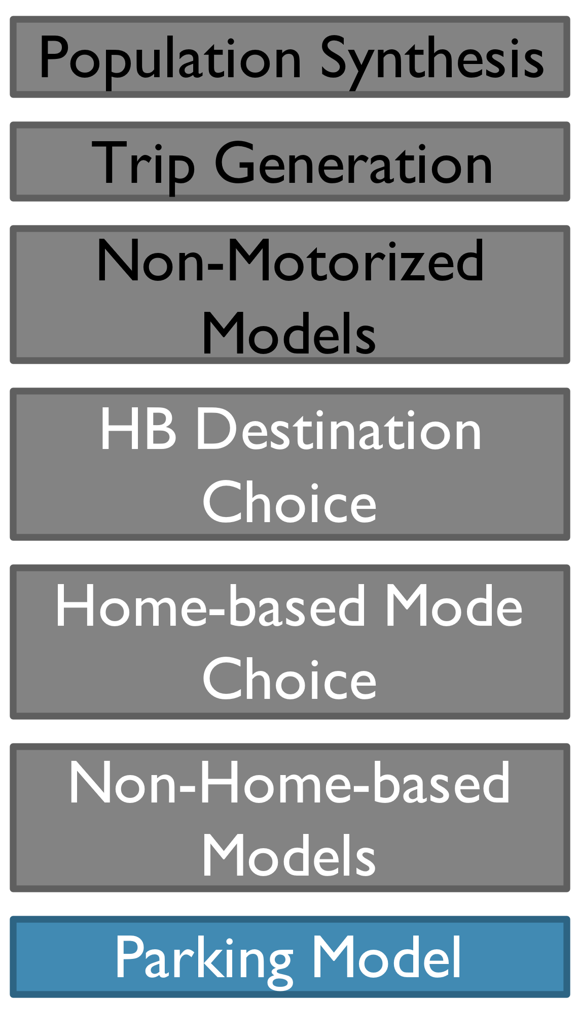
Parking Models
Only for downtown & major campus areas
Based on 2016 survey
Nested Mode & Destination Choice Model
  Lowest level mode choice
    park & shuttle (auto intercept)
    park & walk
  Parking zone choice

Slide 30
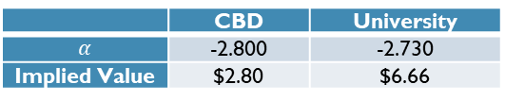
Resulting Parking MOdel
Mode utilities are just logsums of destination utilities plus ASC
 | CBD | University
$$α$$ | -2.800 | -2.730
Implied Value | $2.80 | $6.66

Slide 31
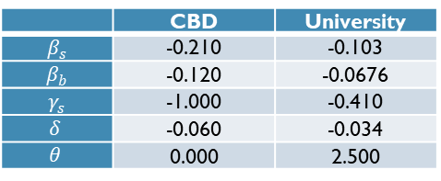
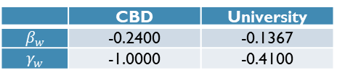
Resulting Parking MOdel
 | CBD | University
$$β_{s}$$ | -0.210 | -0.103
$$β_{b}$$ | -0.120 | -0.0676
$$γ_{s}$$ | -1.000 | -0.410
$$δ$$ | -0.060 | -0.034
$$θ$$ | 0.000 | 2.500
 | CBD | University
$$β_{w}$$ | -0.2400 | -0.1367
$$γ_{w}$$ | -1.0000 | -0.4100

